Slide 1
Figures – Chapter 24

Slide 2
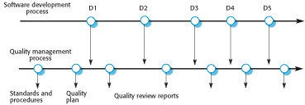
Figure 24.1 Quality management and software development

Slide 3
Figure 24.2 Quality management and software development
Safety | Understandability | Portability
Security | Testability | Usability
Reliability | Adaptability | Reusability
Resilience | Modularity | Efficiency
Robustness | Complexity | Learnability

Slide 4
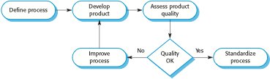
Figure 24.3 Process-based quality

Slide 5
Figure 24.4 Product and process standards
Product standards | Process standards
Design review form | Design review conduct
Requirements document structure | Submission of new code for system building
Method header format | Version release process
Java programming style | Project plan approval process
Project plan format | Change control process
Change request form | Test recording process

Slide 6
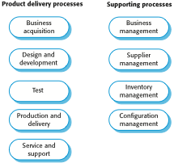
Figure 24.5 ISO 9001 core processes

Slide 7
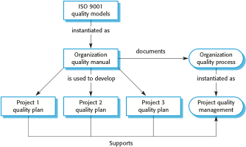
Figure 24.6 ISO 9001 and quality management

Slide 8

Figure 24.7 The software review process

Slide 9
Figure 24.8 An inspection checklist
Fault class | Inspection check
Data faults | Are all program variables initialized before their values are used? Have all constants been named? Should the upper bound of arrays be equal to the size of the array or Size -1? If character strings are used, is a delimiter explicitly assigned? Is there any possibility of buffer overflow?
Control faults | For each conditional statement, is the condition correct? Is each loop certain to terminate? Are compound statements correctly bracketed? In case statements, are all possible cases accounted for? If a break is required after each case in case statements, has it been included?
Input/output faults | Are all input variables used? Are all output variables assigned a value before they are output? Can unexpected inputs cause corruption?
Interface faults | Do all function and method calls have the correct number of parameters? Do formal and actual parameter types match? Are the parameters in the right order? If components access shared memory, do they have the same model of the shared memory structure?
Storage management faults | If a linked structure is modified, have all links been correctly reassigned? If dynamic storage is used, has space been allocated correctly? Is space explicitly deallocated after it is no longer required?
Exception management faults | Have all possible error conditions been taken into account?

Slide 10
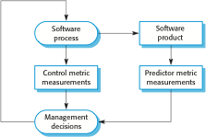
Figure 24.9 Predictor and control measurements

Slide 11
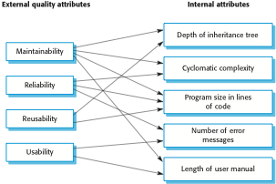
Figure 24.10 Relationships between internal and external software

Slide 12
Figure 24.11 Static software product metrics
Software metric | Description
Fan-in/Fan-out | Fan-in is a measure of the number of functions or methods that call another function or method (say X). Fan-out is the number of functions that are called by function X. A high value for fan-in means that X is tightly coupled to the rest of the design and changes to X will have extensive knock-on effects. A high value for fan-out suggests that the overall complexity of X may be high because of the complexity of the control logic needed to coordinate the called components.
Length of code | This is a measure of the size of a program. Generally, the larger the size of the code of a component, the more complex and error-prone that component is likely to be. Length of code has been shown to be one of the most reliable metrics for predicting error-proneness in components.
Cyclomatic complexity | This is a measure of the control complexity of a program. This control complexity may be related to program understandability. I discuss cyclomatic complexity in Chapter 8.
Length of identifiers | This is a measure of the average length of identifiers (names for variables, classes, methods, etc.) in a program. The longer the identifiers, the more likely they are to be meaningful and hence the more understandable the program.
Depth of conditional nesting | This is a measure of the depth of nesting of if-statements in a program. Deeply nested if-statements are hard to understand and potentially error-prone.
Fog index | This is a measure of the average length of words and sentences in documents. The higher the value of a document’s Fog index, the more difficult the document is to understand.

Slide 13
Figure 24.12 The CK object-oriented metrics suite
Object-oriented metric | Description
Weighted methods per class (WMC) | This is the number of methods in each class, weighted by the complexity of each method. Therefore, a simple method may have a complexity of 1, and a large and complex method a much higher value. The larger the value for this metric, the more complex the object class. Complex objects are more likely to be difficult to understand. They may not be logically cohesive, so cannot be reused effectively as superclasses in an inheritance tree.
Depth of inheritance tree (DIT) | This represents the number of discrete levels in the inheritance tree where subclasses inherit attributes and operations (methods) from superclasses. The deeper the inheritance tree, the more complex the design. Many object classes may have to be understood to understand the object classes at the leaves of the tree.
Number of children (NOC) | This is a measure of the number of immediate subclasses in a class. It measures the breadth of a class hierarchy, whereas DIT measures its depth. A high value for NOC may indicate greater reuse. It may mean that more effort should be made in validating base classes because of the number of subclasses that depend on them.
Coupling between object classes (CBO) | Classes are coupled when methods in one class use methods or instance variables defined in a different class. CBO is a measure of how much coupling exists. A high value for CBO means that classes are highly dependent, and therefore it is more likely that changing one class will affect other classes in the program.
Response for a class (RFC) | RFC is a measure of the number of methods that could potentially be executed in response to a message received by an object of that class. Again, RFC is related to complexity. The higher the value for RFC, the more complex a class and hence the more likely it is that it will include errors.
Lack of cohesion in methods (LCOM) | LCOM is calculated by considering pairs of methods in a class. LCOM is the difference between the number of method pairs without shared attributes and the number of method pairs with shared attributes. The value of this metric has been widely debated and it exists in several variations. It is not clear if it really adds any additional, useful information over and above that provided by other metrics.

Slide 14
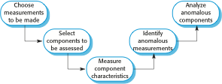
Figure 24.13 The process of product measurement

